Slide 1
SQL
Exam

Slide 2

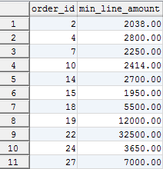
Query Buildings
1. Get all Items containint ‘set’ as description and unit_price between 500 and 23000.
2. Get amount of carts per ShipTo from Cart with Status other than Created.
3. Get the mínimum_line_amount per Order from OrderLines where status_id are among (3100, 3300) and the minumum_line_amount is greater than 1,500.

Slide 3

Query Buildings
4. Create a report from Orders that includes per payment_method_id the total of orders in each Status. The report has to cosider only Order with dada of 2015.

Slide 4
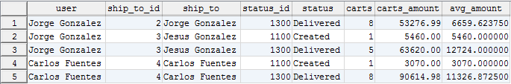
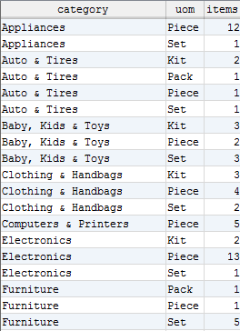
Joins
1. Get the number of carts by ShipTo and Status, from Carts “CREATED” and “DELIVERED” and which the average of cart_amount on each group is between $ 3,000 and $ 15,000.
Include the relevant description for ShipTo and Status.
2. Get the number of Items by Category and UnitOfMeasure.
Sort the result by Category and then by UOM.

Slide 5
Jorge Luis Gonzalez
jorge.gonzalezm@softtek.com
Instructor

